Slide 1

332:479 Concepts in VLSI
Design
Lecture 5
MIPS Processor Example
David Harris
Harvey Mudd College
Spring 2004

Slide 2
Outline
Design Partitioning
MIPS Processor Example
  Architecture
  Microarchitecture
  Logic Design
  Circuit Design
  Physical Design
Fabrication, Packaging, Testing
Summary
Material from: CMOS VLSI Design,
by Weste and Harris, Addison-Wesley, 2005

Slide 3
Coping with Complexity
How to design System-on-Chip?
  Many millions (soon billions!) of transistors
  Tens to hundreds of engineers
Structured Design
Design Partitioning

Slide 4
Structured Design
Hierarchy: Divide and Conquer
  Recursively system into modules
Regularity
  Reuse modules wherever possible
  Ex: Standard cell library
Modularity: well-formed interfaces
  Allows modules to be treated as black boxes
Locality
  Physical and temporal

Slide 5
Abstraction Levels
Synopsys
Design Analyzer
Synopsys
Behavioral
Simulation
ARCHITECTURE & BEHAVIORAL
REGISTER TRANSFER – Verilog/VHDL
LOGIC
SWITCH LEVEL
CIRCUIT (TRANSISTORS)
LAYOUT & TEST PATTERNS
FABRICATION LINE
Envisia
Standard Cell
Place-and-
Route
Cadence
Verilog-XL
Synopsys
Logic Sim.
Dracula
Logic vs.
Layout
SPICE and
Cadence
Spectre
Assura
Circuit
Extractor
Cadence
LayoutPlus
Spectral
Test Pattern Gen.
SUPREM

Slide 6
Design Partitioning
Architecture: User’s perspective, what does it do?
  Instruction set, registers
  MIPS, x86, Alpha, PIC, ARM, …
Microarchitecture
  Single cycle, multcycle, pipelined, superscalar?
Logic: how are functional blocks constructed
  Ripple carry, carry lookahead, carry select adders
Circuit: how are transistors used
  Complementary CMOS, pass transistors, domino
Physical: chip layout
  Datapaths, memories, random logic

Slide 7
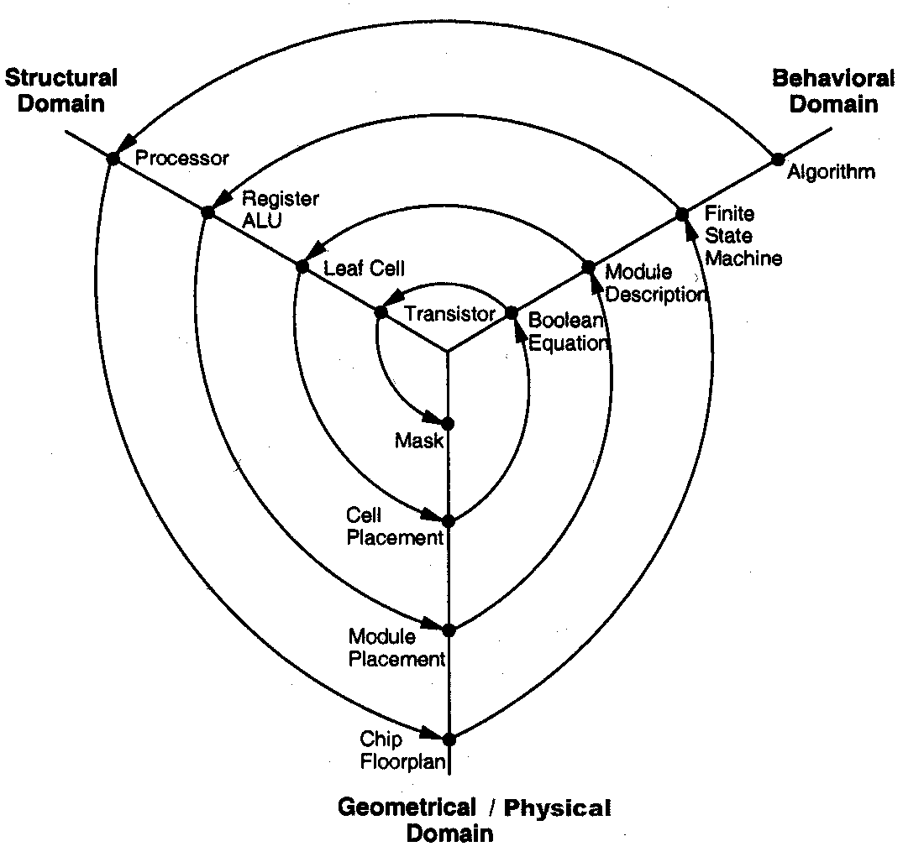
Gajski Y-Chart

Slide 8
MIPS Architecture
Example: subset of MIPS processor architecture
  Drawn from Patterson & Hennessy
MIPS is a 32-bit architecture with 32 registers
  Consider 8-bit subset using 8-bit datapath
  Only implement 8 registers ($0 - $7)
  $0 hardwired to 00000000
  8-bit program counter
You’ll build this processor in the labs
  Illustrate the key concepts in VLSI design

Slide 9
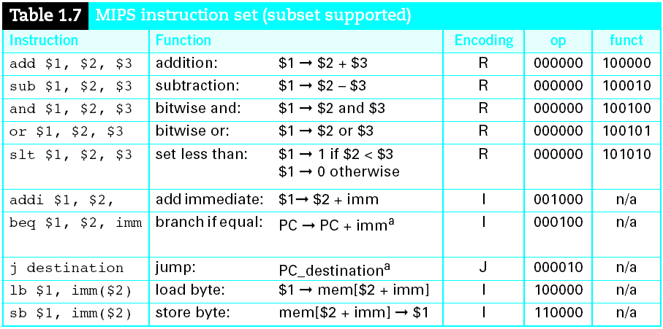
Instruction Set

Slide 10
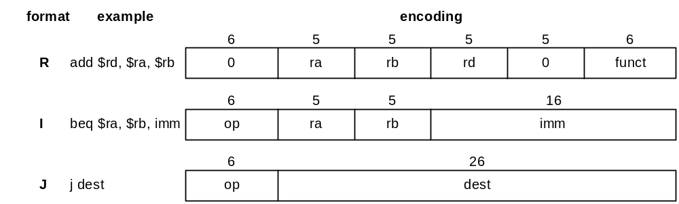
Instruction Encoding
32-bit instruction encoding
  Requires four cycles to fetch on 8-bit datapath

Slide 11
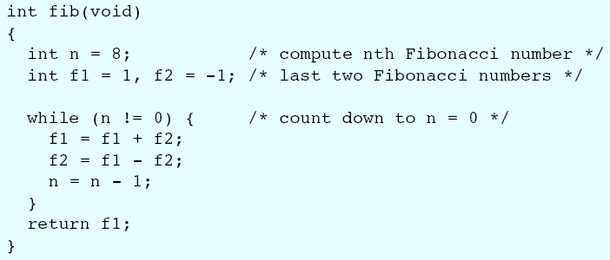
Fibonacci (C)
f₀ = 1; f₋₁ = -1
f_{n} = f_{n-1} + f_{n-2}
f = 1, 1, 2, 3, 5, 8, 13, …

Slide 12
Fibonacci (Assembly)
1st statement: n = 8
How do we translate this to assembly?

Slide 13
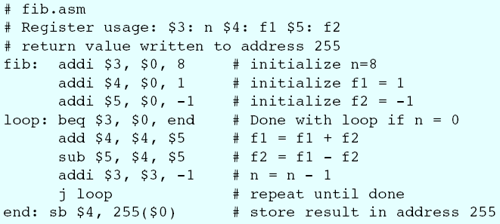
Fibonacci (Assembly)

Slide 14
Fibonacci (Binary)
1st statement: addi $3, $0, 8
How do we translate this to machine language?
  Hint: use instruction encodings below

Slide 15
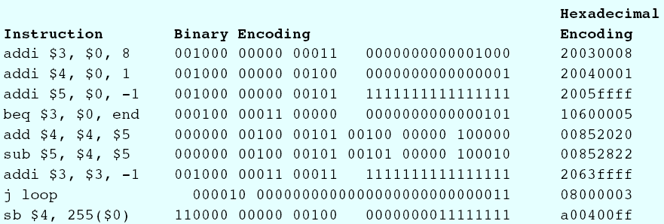
Fibonacci (Binary)
Machine language program

Slide 16
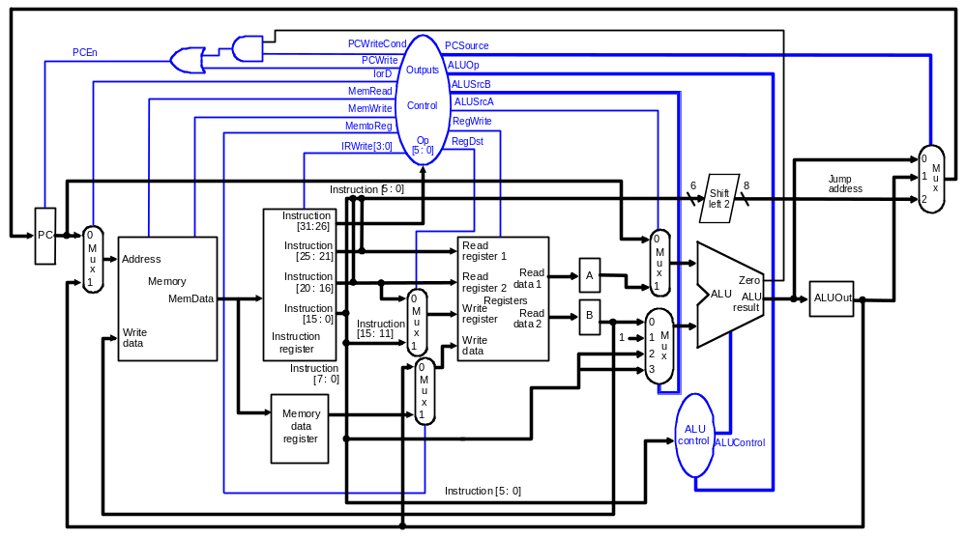
MIPS Microarchitecture
Multicycle μarchitecture from Patterson & Hennessy

Slide 17
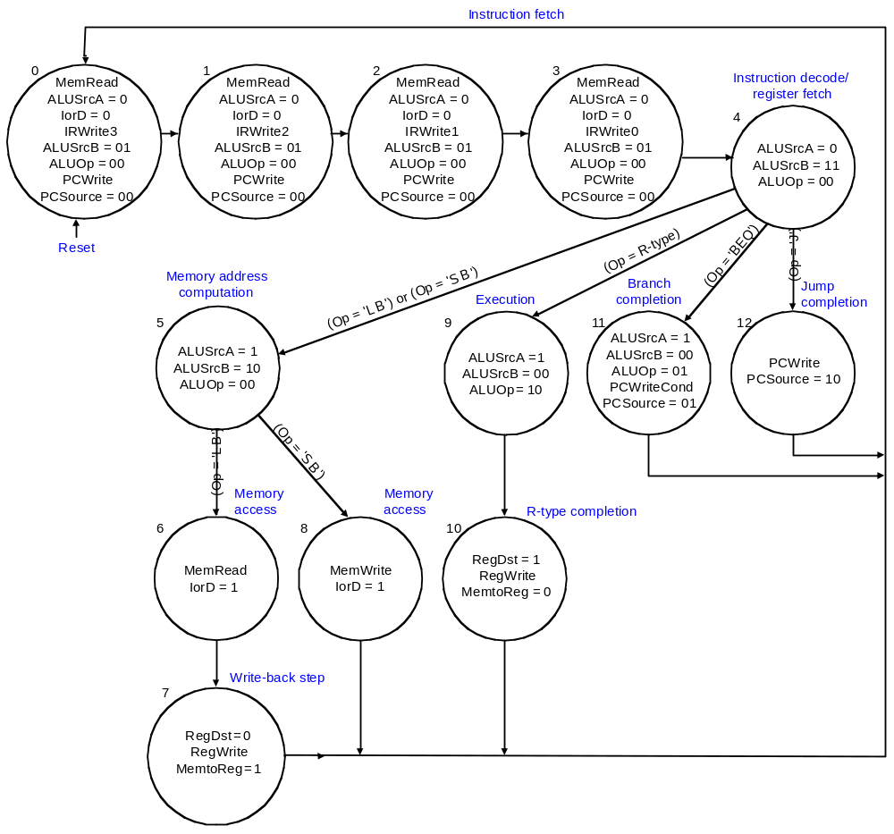
Multicycle Controller

Slide 18
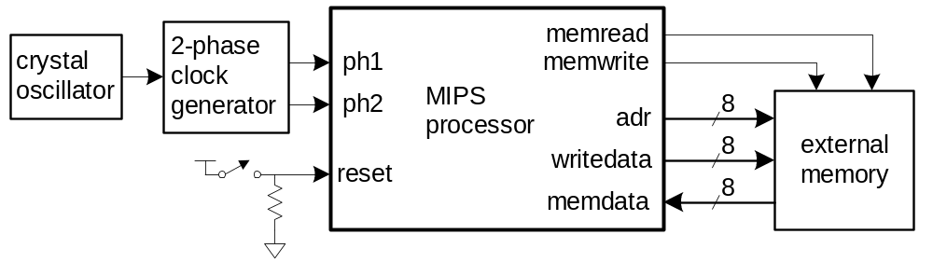
Logic Design
Start at top level
  Hierarchically decompose MIPS into units
Top-level interface

Slide 19
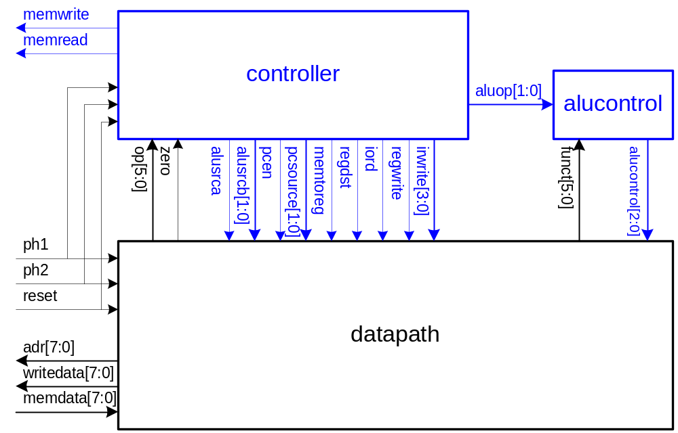
Block Diagram

Slide 20
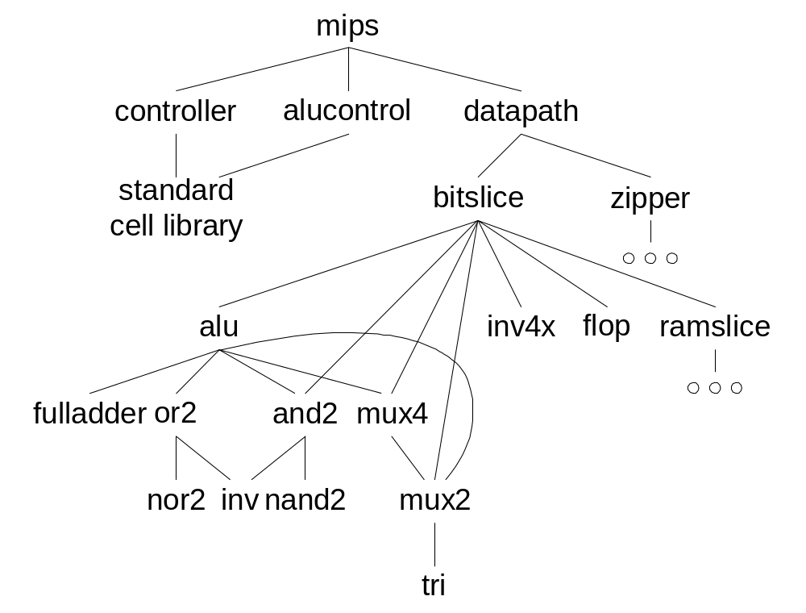
Hierarchical Design

Slide 21
HDLs
Hardware Description Languages
  Widely used in logic design
  Verilog and VHDL
Describe hardware using code
  Document logic functions
  Simulate logic before building
  Synthesize code into gates and layout
    Requires a library of standard cells

Slide 22
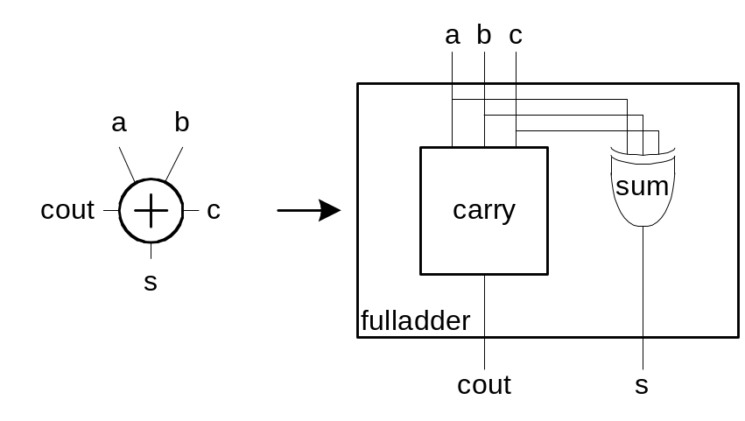
Verilog Example
module fulladder(input a, b, c,
output s, cout);
sum s1(a, b, c, s);
carry c1(a, b, c, cout);
endmodule
module carry(input a, b, c,
output cout)
assign cout = (a&b) | (a&c) | (b&c);
endmodule

Slide 23
Circuit Design
How should logic be implemented?
  NANDs and NORs vs. ANDs and ORs?
  Fan-in and fan-out?
  How wide should transistors be?
These choices affect speed, area, power
Logic synthesis makes these choices for you
  Good enough for many applications
  Hand-crafted circuits are still better

Slide 24
Example: Carry Logic
assign cout = (a&b) | (a&c) | (b&c);
Transistors? Gate Delays?

Slide 25
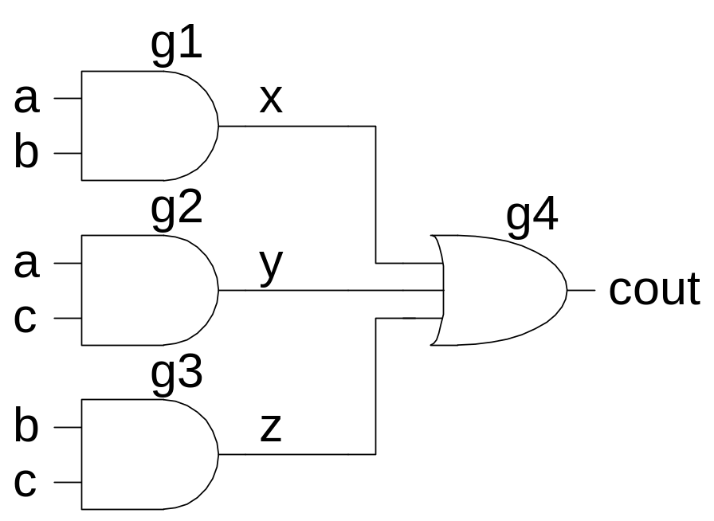
Example: Carry Logic
assign cout = (a&b) | (a&c) | (b&c);
Transistors? Gate Delays?

Slide 26
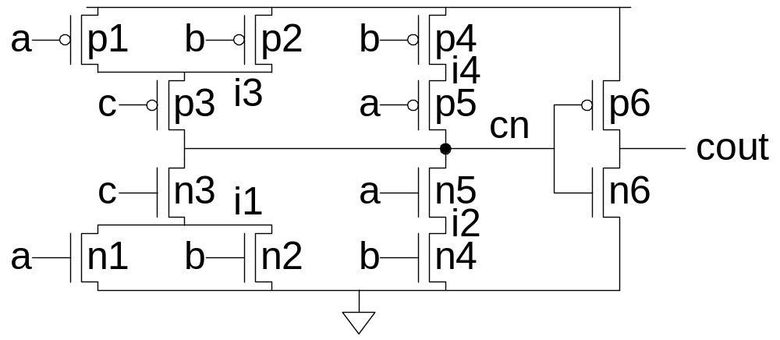
Example: Carry Logic
assign cout = (a&b) | (a&c) | (b&c);
Transistors? Gate Delays?

Slide 27
Gate-Level Netlist
module carry(input a, b, c,
output cout)
wire x, y, z;
and g1(x, a, b);
and g2(y, a, c);
and g3(z, b, c);
or g4(cout, x, y, z);
endmodule

Slide 28
Transistor-Level Netlist
module carry(input a, b, c,
output cout)
wire i1, i2, i3, i4, cn;
tranif1 n1(i1, 0, a);
tranif1 n2(i1, 0, b);
tranif1 n3(cn, i1, c);
tranif1 n4(i2, 0, b);
tranif1 n5(cn, i2, a);
tranif0 p1(i3, 1, a);
tranif0 p2(i3, 1, b);
tranif0 p3(cn, i3, c);
tranif0 p4(i4, 1, b);
tranif0 p5(cn, i4, a);
tranif1 n6(cout, 0, cn);
tranif0 p6(cout, 1, cn);
endmodule

Slide 29
SPICE Netlist
.SUBCKT CARRY A B C COUT VDD GND
MN1 I1 A GND GND NMOS W=1U L=0.18U AD=0.3P AS=0.5P
MN2 I1 B GND GND NMOS W=1U L=0.18U AD=0.3P AS=0.5P
MN3 CN C I1 GND NMOS W=1U L=0.18U AD=0.5P AS=0.5P
MN4 I2 B GND GND NMOS W=1U L=0.18U AD=0.15P AS=0.5P
MN5 CN A I2 GND NMOS W=1U L=0.18U AD=0.5P AS=0.15P
MP1 I3 A VDD VDD PMOS W=2U L=0.18U AD=0.6P AS=1 P
MP2 I3 B VDD VDD PMOS W=2U L=0.18U AD=0.6P AS=1P
MP3 CN C I3 VDD PMOS W=2U L=0.18U AD=1P AS=1P
MP4 I4 B VDD VDD PMOS W=2U L=0.18U AD=0.3P AS=1P
MP5 CN A I4 VDD PMOS W=2U L=0.18U AD=1P AS=0.3P
MN6 COUT CN GND GND NMOS W=2U L=0.18U AD=1P AS=1P
MP6 COUT CN VDD VDD PMOS W=4U L=0.18U AD=2P AS=2P
CI1 I1 GND 2FF
CI3 I3 GND 3FF
CA A GND 4FF
CB B GND 4FF
CC C GND 2FF
CCN CN GND 4FF
CCOUT COUT GND 2FF
.ENDS

Slide 30
Physical Design
Floorplan
Standard cells
  Place & route
Datapaths
  Slice planning
Area estimation

Slide 31
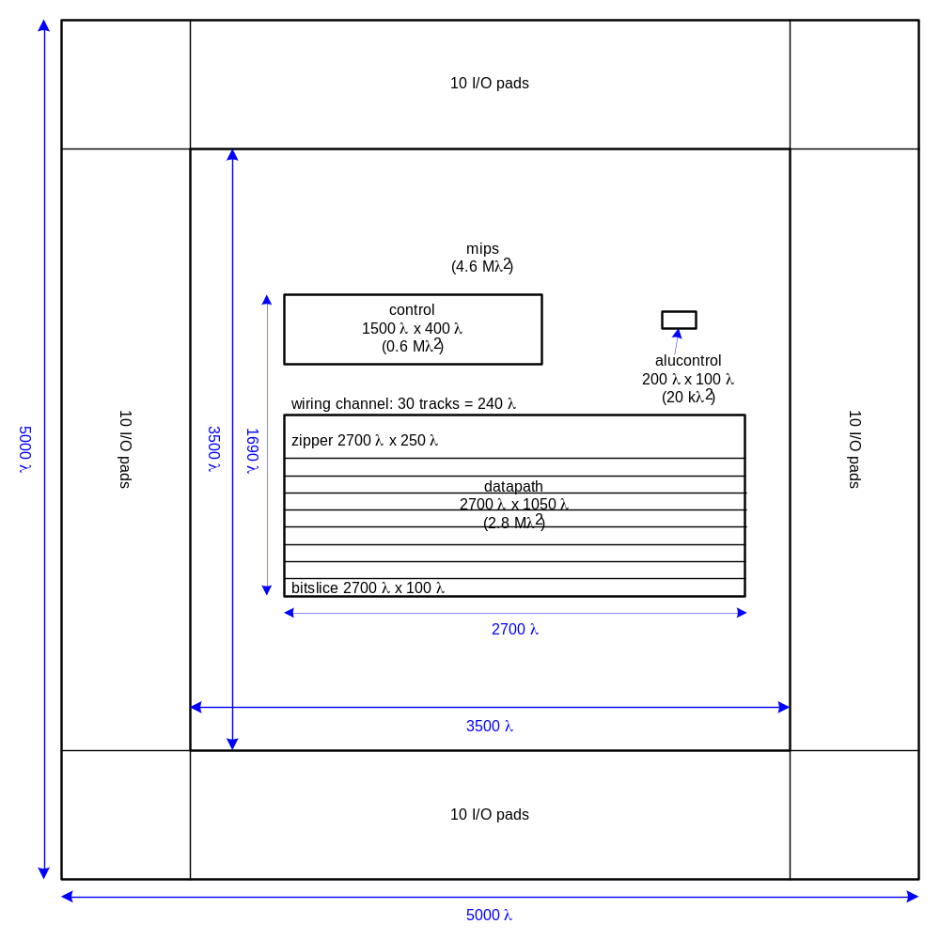
MIPS Floorplan

Slide 32
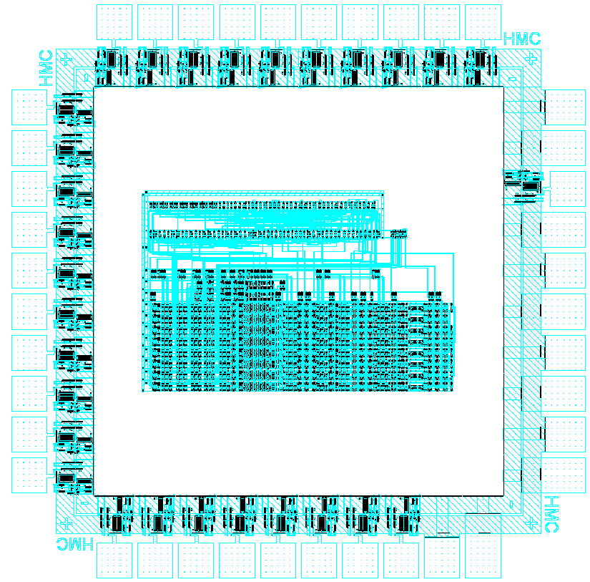
MIPS Layout

Slide 33
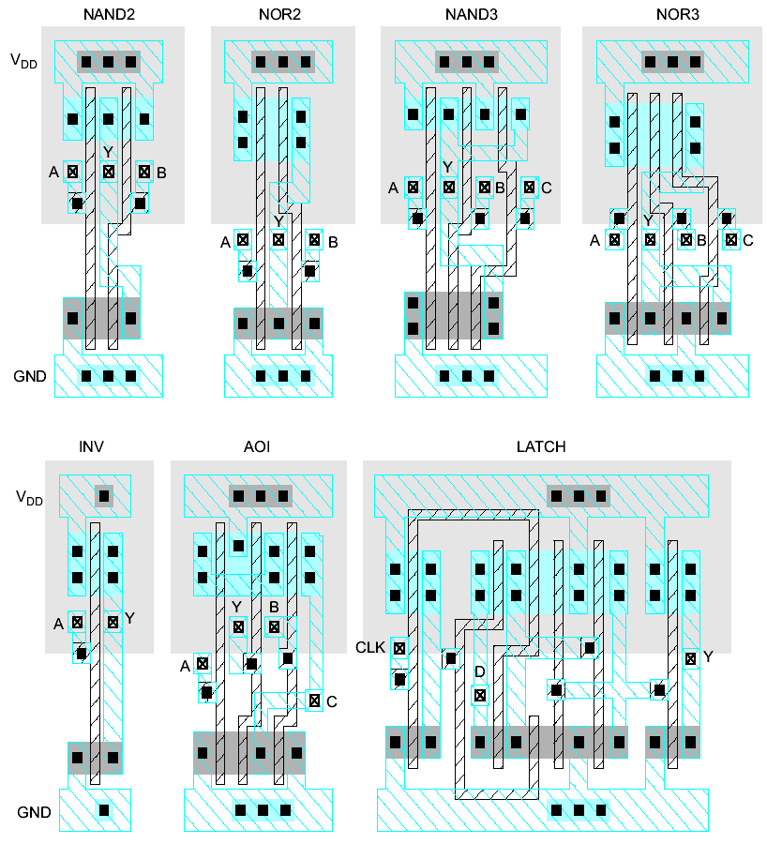
Standard Cells
Uniform cell height
Uniform well height
M1 V_{DD} and GND rails
M2 Access to I/Os
Well / substrate taps
Exploits regularity

Slide 34
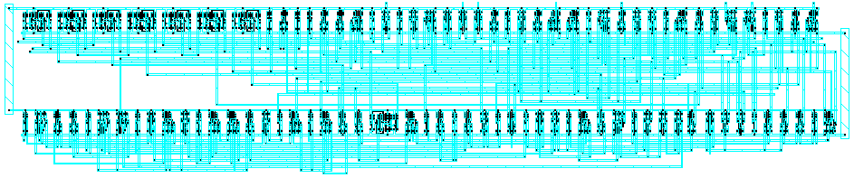
Synthesized Controller
Synthesize HDL into gate-level netlist
Place & Route using standard cell library

Slide 35
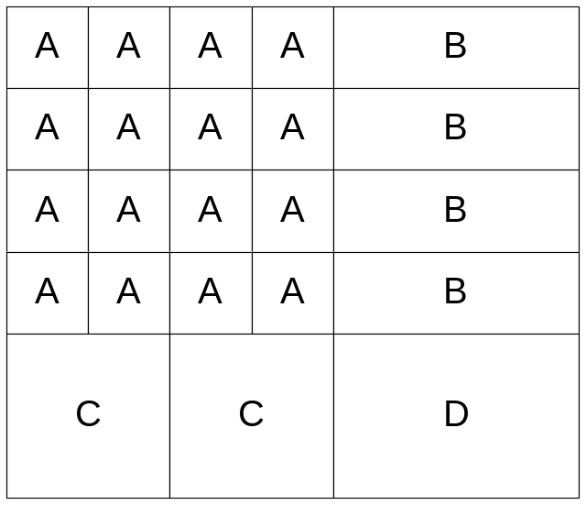
Pitch Matching
Synthesized controller area is mostly wires
  Design is smaller if wires run through/over cells
  Smaller = faster, lower power as well!
Design snap-together cells for datapaths and arrays
  Plan wires into cells
  Connect by abutment
    Exploits locality
    Takes lots of effort

Slide 36
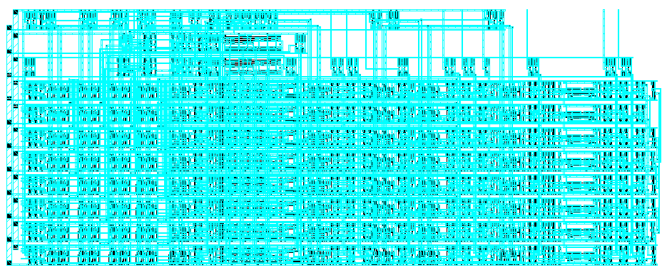
MIPS Datapath
8-bit datapath built from 8 bitslices (regularity)
Zipper at top drives control signals to datapath

Slide 37
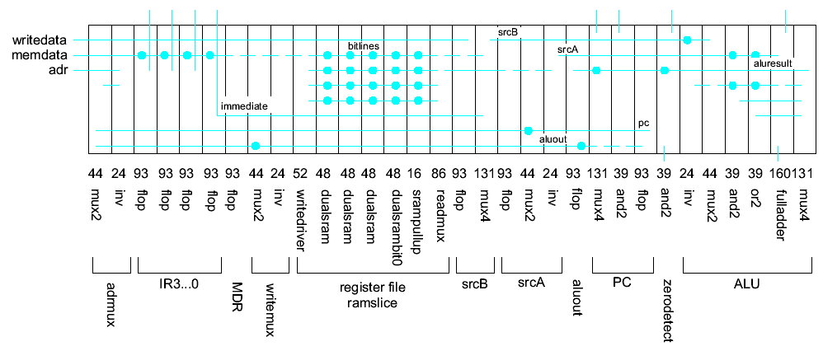
Slice Plans
Slice plan for bitslice
  Cell ordering, dimensions, wiring tracks
  Arrange cells for wiring locality

Slide 38
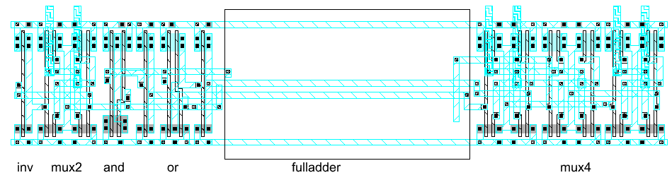
MIPS ALU
Arithmetic / Logic Unit is part of bitslice

Slide 39
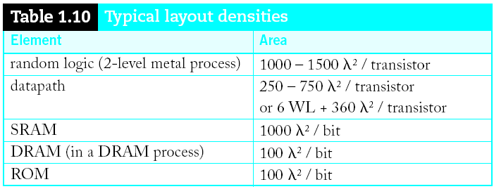
Area Estimation
Need area estimates to make floorplan
  Compare to another block you already designed
  Or estimate from transistor counts
  Budget room for large wiring tracks
  Your mileage may vary!

Slide 40
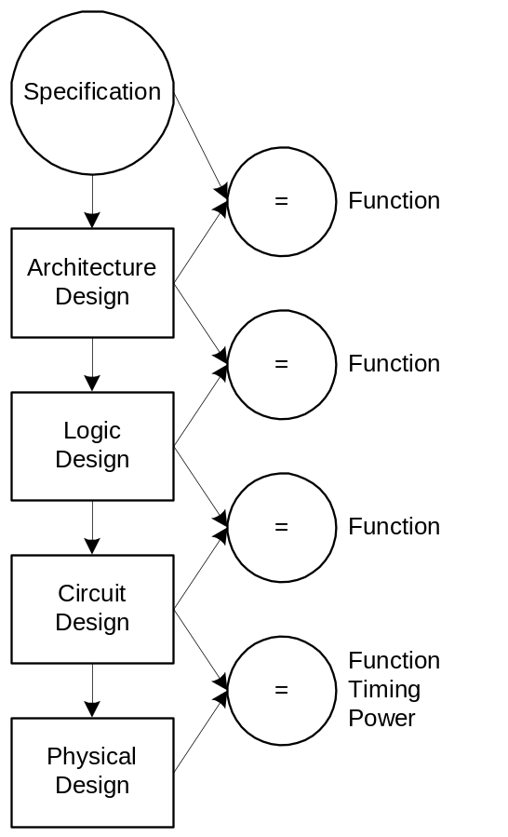
Design Verification
Fabrication is slow & expensive
  MOSIS 0.6μm: $1000, 3 months
  State of art: $1M, 1 month
Debugging chips is very hard
  Limited visibility into operation
Prove design is right before building!
  Logic simulation
  Ckt. simulation / formal verification
  Layout vs. schematic comparison
  Design & electrical rule checks
Verification is > 50% of effort on most chips!

Slide 41
Technology CAD
Design Rule Checker
Electrical Rule Checker
  Circuit Extraction from layout
    Logic vs. layout check

Slide 42
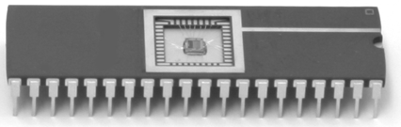
Fabrication & Packaging
Tapeout final layout
Fabrication
  6, 8, 12” wafers
  Optimized for throughput, not latency (10 weeks!)
  Cut into individual dice
Packaging
  Bond gold wires from die I/O pads to package

Slide 43
Testing
Test that chip operates
  Design errors
  Manufacturing errors
A single dust particle or wafer defect kills a die
  Yields from 90% to < 10%
  Depends on die size, maturity of process
  Test each part before shipping to customer

Slide 44
Summary
Design Partitioning
MIPS Processor Example
  Architecture
  Microarchitecture
  Logic Design
  Circuit Design
  Physical Design
Fabrication, Packaging, Testing

